Slide 1
Fundamentals of Cognitive Computing

Slide 2
Unit Objectives
Define the main characteristics of a cognitive system
Explain neural nets
Explain machine learning technologies (supervised, unsupervised, reinforcement learning approaches)
Define a common set of use cases for cognitive systems
Define Precision, Recall, and Accuracy
Explain the importance of separating training, validation and test data
Measure accuracy of service
Define types of entities, relationships and co-references
Define Intents and Classes

Slide 3
Cognitive Systems
Focus of cognitive systems is not about doing fast calculations on large amounts of data through traditional computer programs.
Focuses on exploring the data, finding new correlations, and new context in that data to provide new solutions.
Aims at expanding the boundaries of human cognition rather than replacing or replicating the way the human brain works.
“Cognitive computing refers to systems that learn at scale, reason with purpose and interact with humans naturally. Rather than being explicitly programmed, they learn and reason from their interactions with us and from their experiences with their environment.”
- Dr. John E. Kelly III, October, 2015

Slide 4
Basic concepts
Cognition
the process of acquiring knowledge through thoughts, experiences, and senses.
Artificial Intelligence (AI)
the study and development of AI systems aim at building computer systems able to perform tasks that normally require human intelligence.
Cognitive computing
is among the sub-disciplines that shape AI. It is about putting together a system that combines the best of human and machine capabilities.
Big data
innovative forms of information processing to draw insights, automate processes, and assist in decision making.
can be structured data , semi-structured or unstructured such as word processing documents, videos, images, audio, presentations, social media interactions, streams, web pages, and many other kinds of content.

Slide 5
Basic concepts
Question-answering (QA) technology
can ingest millions of pages of text and apply question-answering technology to respond to questions posed by humans in natural language.
Machine learning (ML)
Machine learning is a type of AI that gives computers the ability to learn and act without being explicitly programmed.
Natural language processing (NLP)
NLP is the ability of computer software to understand human speech
(example: spam detection in email)
Cloud computing…
Application program interfaces…

Slide 6
Characteristics of cognitive systems
Combine the strengths of human (deep thinking and complex problem solving) and computer ( reading, analyzing and leveraging huge volumes of data) into a collaborative solution.
Cognitive systems should have more natural interaction between computers and humans (Speech recognition)
Use of learning, specifically machine learning.
Should broaden the potential for learning and the ability of a to adapt over time with use.
“Cognitive systems have by far begun to
Understand, Reason, Learn and Interact with humans”

Slide 7
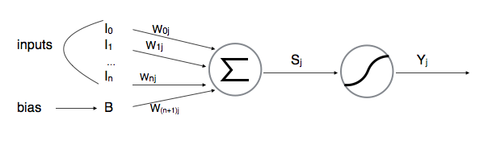
Neural Networks
Neuron
Neurons are the basic unit of a neural network.
Neurons contain:
a number of dendrites (inputs),
a cell nucleus (processor) and
an axon (output).
When the neuron activates
it accumulates all its incoming inputs, and
if it goes over a certain threshold it fires a signal thru the axon.

Slide 8
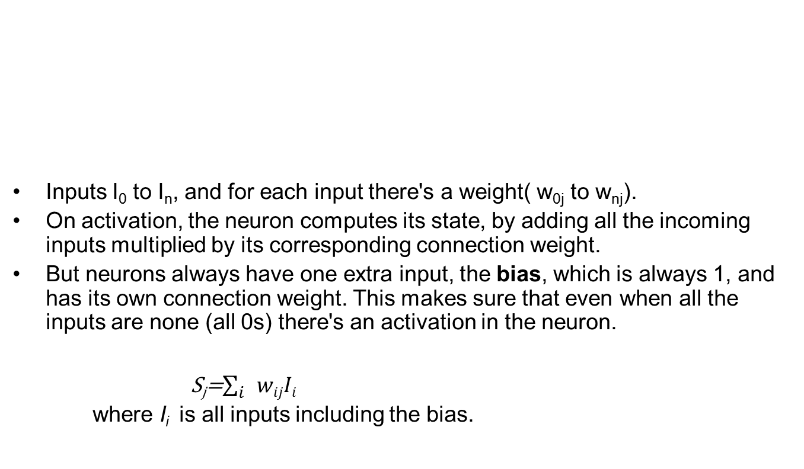
Neuron representation
Inputs I₀ to I_{n}, and for each input there's a weight( w_{0j} to w_{nj}).
On activation, the neuron computes its state, by adding all the incoming inputs multiplied by its corresponding connection weight.
But neurons always have one extra input, the bias, which is always 1, and has its own connection weight. This makes sure that even when all the inputs are none (all 0s) there's an activation in the neuron.
S_{j}=$\sum_{i}{wijIi}$
where I_{i} is all inputs including the bias.

Slide 9
Learning in neural networks in a nutshell
Neural networks learn by training
Upon giving an input, the network shall produce an output.
The next major step is to teach the network what should have been the ideal output for the given input.
Now the network shall start to adjust the weights according to the ideal output to produce a more accurate output for the next time (back propagation)
The process is repeated until error between the ideal output and the output is minimal.

Slide 10
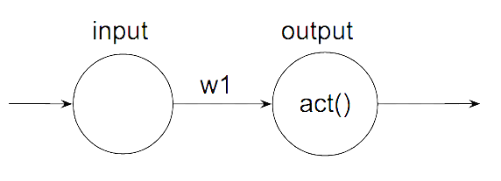
Understanding weights and bias
For each nueron input there is a weight (the weight of that specific connection).
When a artificial neuron activates if computes its state by adding all the incoming inputs multiplied by it's corresponding connection weight.
Neurons always have one extra input, the bias which is always 1 and has it's own connection weight( this makes sure that even when all other inputs are none there's going to be activation in the nueron).

Slide 11
A simple numerical example
Consider the dataset as below:
Now, the relationship between the input(x) and the desired output(y) is
y=2(x)(we will not be assuming we know this answer), but not the case in real datasets(esp. when the relation between the input and output is highly non-linear).
Input | Desired output
0 | 0
1 | 2
2 | 4
3 | 6
4 | 8

Slide 12
Step 1: Model initialization
Let us go with a random initialization of y=3(x) to obtain the solution.
Step 2: Forward propagate
Once initialized the model has to be checked for performance.
We start from the input we have, we pass them through the network layer and calculate the actual output of the model straightforwardly.
Input | Actual output of model 1 (y= 3.x)
0 | 0
1 | 3
2 | 6
3 | 9
4 | 12

Slide 13
Step 3- Loss function
At this stage, in one hand, we have the actual output of the randomly initialized neural network.
On the other hand, we have the desired output we would like the network to learn. Let’s put them all in the same table.
Input | Actual output | Desired output
0 | 0 | 0
1 | 3 | 2
2 | 6 | 4
3 | 9 | 6
4 | 12 | 8

Slide 14
The most intuitive loss function is simply loss = (Desired output - actual output).
This loss function returns
positive values when the network undershoot (prediction < desired output), and
negative values when the network overshoot (prediction > desired output).
If we want the loss function to reflect an absolute error on the performance regardless if it’s overshooting or undershooting we can define it as: loss = Abstract value of (desired - actual ).
Input | Actual | Desired | Absolute Error | Square Error
0 | 0 | 0 | 0 | 0
1 | 3 | 2 | 1 | 1
2 | 6 | 4 | 2 | 4
3 | 9 | 6 | 3 | 9
4 | 12 | 8 | 4 | 16
Total: | - | - | 10 | 30

Slide 15
Step 4: Differentiation
Any optimization technique that modifies the internal weights of neural networks in order to minimize the total loss function can be used.
As of the defined problem we can make changes to the weight W in order to optimize the sum of squares of errors over the dataset.
Now for example:
In order to see the effect of the derivative, how much the total error will change if we change the internal weight of the neural network with a certain small value δW.
For the sake of simplicity will consider δW=0.0001(in reality it should be much smaller!).

Slide 16
Recalculating the sum of the squares of errors when the weight W changes very slightly, we get the following:
Input | Desired Output | W=3 | Square Error | W=3.0001 | Square Error
0 | 0 | 0 | 0 | 0 | 0
1 | 2 | 3 | 1 | 3.0001 | 1.0002
2 | 4 | 6 | 4 | 6.0002 | 4.0008
3 | 6 | 9 | 9 | 9.0003 | 9.0018
4 | 8 | 12 | 16 | 12.0004 | 16.0032
Total: | - | - | 30 | - | 30.006

Slide 17
If we increase W from 3 to 3.0001, the sum of squares of error will increase from 30 to 30.006.
Since we know that the best function that fits this model is y=2.x, increasing the weights from 3 to 3.0001 should obviously create a little bit more error (because we are going further from the intuitive correct weight of 2. 3.0001 > 3 > 2 thus the error is higher)
Here is what our loss function looks like:
If w=2, we have a loss of 0, since the neural network actual output will fit perfectly the training set.
If w<2, we have a positive loss function, but the derivative is negative, meaning that an increase of weight will decrease the loss function.
At w=2, the loss is 0 and the derivative is 0, we reached a perfect model, nothing is needed.
If w>2, the loss becomes positive again, but the derivative is as well positive, meaning that any more increase in the weight, will increase the losses even more!!

Slide 18
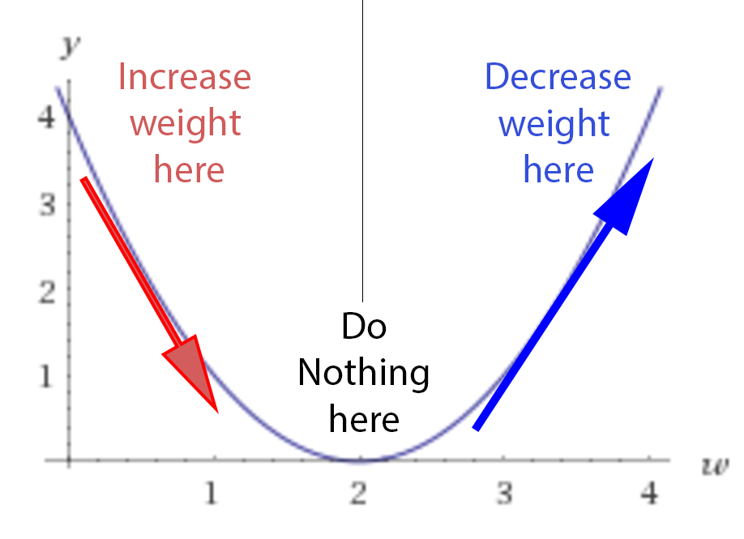
Diagrammatically – Weight adjustment

Slide 19
Backpropagation in Neural Networks
The true power of neural networks is their multilayer variant. Training single-layer perceptrons is straightforward, but the resulting network is not very powerful.
How can we train networks that have multiple layers? This is where backpropagation came in.
Backpropagation is an algorithm for training neural networks that have many layers.
It works in two phases.
The first phase is the propagation of inputs through a neural network to the final layer (called feedforward).
In the second phase, the algorithm computes an error, and then backpropagates this error (adjusting the weights) from the final layer to the first.

Slide 20
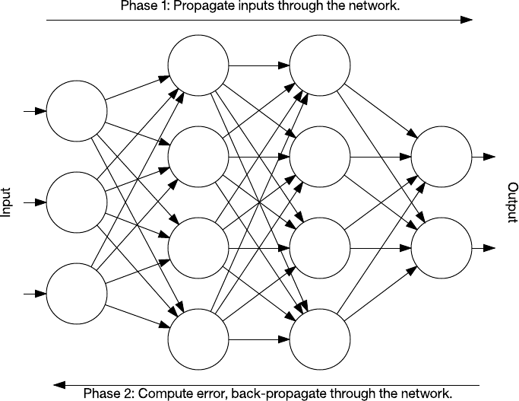
Backpropagation
The figure represents feedforward(input to output) and backpropagation(error delta for weight adjustment)

Slide 21
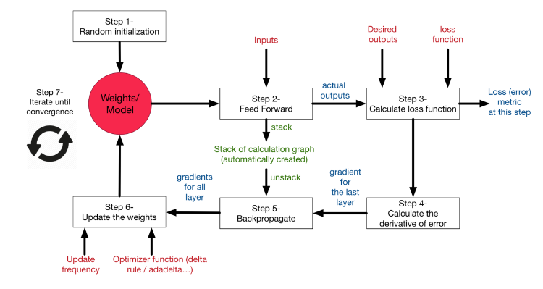
The overall picture of NN with backpropagation and weight adjustment

Slide 22
Overfitting and Underfitting
Overfitting
Overfitting is the process of overgeneralizing in a training process by providing a fewer training data pairs for one set of cases. The model learns the training data so well that when it is given a random set, the model performs poorly.
For example, a model that is trained to predict median house values that are based on wealthy neighborhoods will perform poorly when it is tested with a middle-class neighborhood. One way to avoid overfitting is to collect a large amount of training data or to create a resampled set of a training set.
Underfitting
Underfitting is the opposite of overfitting. The model is too simple to learn the underlying structure of data. For example, a linear model of life satisfaction is a model that is prone to underfit because the reality is too complex to be measured. To avoid underfitting, feed more features to the learning algorithm or use a more powerful learning algorithm.

Slide 23
Learning Modes
Supervised
Dataset is labeled i.e. based on the inputs and actual outputs obtained, internal weight adjustments are made to minimize the error gap between expected versus desired output.
Unsupervised
Dataset is unlabeled, so based on the input data the system should be able to reponses (unlabeled)
Semi Supervised
Based on a labeled dataset used for training, the system should be able to predict responses for a newer set of inputs.

Slide 24
Supervised Machine Learning
The majority of practical machine learning uses supervised learning.
Supervised learning is where you have input variables (x) and an output variable (Y) and you use an algorithm to learn the mapping function from the input to the output.
Y = f(X)
The goal is to approximate the mapping function so well that when you have new input data (x) that you can predict the output variables (Y) for that data.
It is called supervised learning because the process of an algorithm learning from the training dataset can be thought of as a teacher supervising the learning process. We know the correct answers, the algorithm iteratively makes predictions on the training data and is corrected by the teacher. Learning stops when the algorithm achieves an acceptable level of performance.

Slide 25
Supervised Machine Learning
Supervised learning problems can be further grouped into regression and classification problems.
Classification: A classification problem is when the output variable is a category, such as “red” or “blue” or “disease” and “no disease”.
Regression: A regression problem is when the output variable is a real value, such as “dollars” or “weight”.
Example:
Classification: Machine is trained to classify something into some class.
classifying whether a patient has disease or not
classifying whether an email is spam or not
Regression: Machine is trained to predict some value like price, weight or height.
predicting house/property price
predicting stock market price

Slide 26
Supervised Machine Learning
Some common types of problems built on top of classification and regression include recommendation and time series prediction respectively.
Some popular examples of supervised machine learning algorithms are:
Linear regression for regression problems.
Random forest for classification and regression problems.
Support vector machines for classification problems.

Slide 27
Supervised Machine Learning
This is simple and you would have done it a number of times, for example:
Cortana or any speech automated system in your mobile phone trains your voice and then starts working based on this training.
Based on various features (past record of head-to-head, pitch, toss, player-vs-player) WASP predicts the winning % of both teams.
Train your handwriting to OCR system and once trained, it will be able to convert your hand-writing images into text (till some accuracy obviously)
Based on some prior knowledge (when its sunny, temperature is higher; when its cloudy, humidity is higher, etc.) weather apps predict the parameters for a given time.
Based on past information about spams, filtering out a new incoming email into Inbox (normal) or Junk folder (Spam)
Biometric attendance or ATM etc systems where you train the machine after couple of inputs (of your biometric identity - be it thumb or iris or ear-lobe, etc.), machine can validate your future input and identify you.

Slide 28
Unsupervised Machine Learning
Unsupervised learning is where you only have input data (X) and no corresponding output variables.
The goal for unsupervised learning is to model the underlying structure or distribution in the data in order to learn more about the data.
These are called unsupervised learning because unlike supervised learning above there is no correct answers and there is no teacher. Algorithms are left to their own devises to discover and present the interesting structure in the data.

Slide 29
Unsupervised Machine Learning
Unsupervised learning problems can be further grouped into clustering and association problems.
Clustering: A clustering problem is where you want to discover the inherent groupings in the data, such as grouping customers by purchasing behavior.
Association: An association rule learning problem is where you want to discover rules that describe large portions of your data, such as people that buy X also tend to buy Y.
Example:
Clustering: A clustering problem is where you want to discover the inherent groupings in the data
such as grouping customers by purchasing behavior
Association: An association rule learning problem is where you want to discover rules that describe large portions of your data
such as people that buy X also tend to buy Y

Slide 30
Unsupervised Machine Learning
Some popular examples of unsupervised learning algorithms are:
k-means for clustering problems.
Apriori algorithm for association rule learning problems.

Slide 31
Unsupervised Machine Learning
Unsupervised Learning
A friend invites you to his party where you meet totally strangers. Now you will classify them using unsupervised learning (no prior knowledge) and this classification can be on the basis of gender, age group, dressing, educational qualification or whatever way you would like. Why this learning is different from Supervised Learning? Since you didn't use any past/prior knowledge about people and classified them "on-the-go".
NASA discovers new heavenly bodies and finds them different from previously known astronomical objects - stars, planets, asteroids, blackholes etc. (i.e. it has no knowledge about these new bodies) and classifies them the way it would like to (distance from Milky way, intensity, gravitational force, red/blue shift or whatever)
Let's suppose you have never seen a Cricket match before and by chance watch a video on internet, now you can classify players on the basis of different criterion: Players wearing same sort of kits are in one class, Players of one style are in one class (batsmen, bowler, fielders), or on the basis of playing hand (RH vs LH) or whatever way you would observe [and classify] it.
We are conducting a survey of 500 questions about predicting the IQ level of students in a college. Since this questionnaire is too big, so after 100 students, administration decides to trim the questionnaire down to fewer questions and for it we use some statistical procedure like PCA to trim it down.

Slide 32
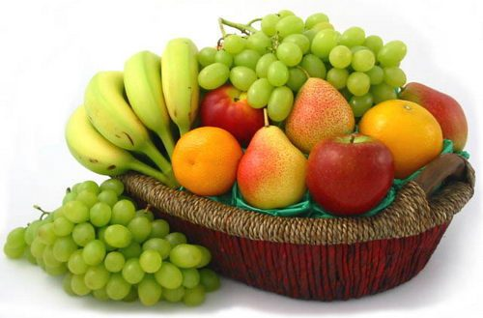
Example

Slide 33
Supervised Learning:
You already learn from your previous work about the physical characters of fruits
So arranging the same type of fruits at one place is easy now
In data mining terminology the earlier work is called as training the data
You already learn the things from your train data. This is because of response variable
Response variable means just a decision variable
You can observe response variable below (FRUIT NAME)

Slide 34
Supervised Learning:
Suppose you have taken a new fruit from the basket then you will see the size, color, and shape of that particular fruit.
If size is Big, color is Red, the shape is rounded shape with a depression at the top, you will confirm the fruit name as apple and you will put in apple group.
Likewise for other fruits also.
The job of grouping fruits was done and the happy ending.
You can observe in the table that a column was labeled as “FRUIT NAME“. This is called as a response variable.
If you learn the thing before from training data and then applying that knowledge to the test data(for new fruit), This type of learning is called as Supervised Learning.

Slide 35
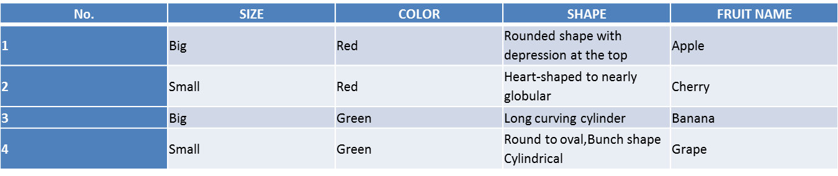
Supervised Learning:

Slide 36
Supervised Learning:
Supervised Learning Algorithms:
All classification and regression algorithms come under supervised learning.
Logistic Regression
Decision trees
Support vector machine (SVM)
k-Nearest Neighbors
Naive Bayes
Random forest
Linear regression
polynomial regression
SVM for regression

Slide 37
Unsupervised Learning:
Suppose you have a basket and it is filled with some different types of fruits and your task is to arrange them as groups.
This time, you don’t know anything about the fruits, honestly saying this is the first time you have seen them. You have no clue about those.
So, how will you arrange them?
What will you do first???
You will take a fruit and you will arrange them by considering the physical character of that particular fruit.

Slide 38
Unsupervised Learning:
Suppose you have considered color.
Then you will arrange them on considering base condition as color.
Then the groups will be something like this.
RED COLOR GROUP: apples & cherry fruits.
GREEN COLOR GROUP: bananas & grapes.
So now you will take another physical character such as size.
RED COLOR AND BIG SIZE: apple.
RED COLOR AND SMALL SIZE: cherry fruits.
GREEN COLOR AND BIG SIZE: bananas.
GREEN COLOR AND SMALL SIZE: grapes.
The job has done, the happy ending.
Here you did not learn anything before ,means no train data and no response variable.
In data mining or machine learning, this kind of learning is known as unsupervised learning.

Slide 39
Unsupervised Learning:
Unsupervised learning algorithms:
All clustering algorithms come under unsupervised learning algorithms.
K – means clustering
Hierarchical clustering
Hidden Markov models

Slide 40
Common set of use cases for cognitive systems
Customer Call Centers
Customer: Go Moment
Problems Solved:
a) Detect the topic of a ticket and route to the appropriate department to handle it
b) room service, maintenance, housekeeping
c) Escalate support tickets based on customer sentiment
d) Route support requests to agents that already solved similar problems by detecting natural language similarities between new customer tickets and resolved ones.
Services used: natural language (text) classification, keyword extraction, entity extraction, and sentiment/tone analysis
Physicians
Expert Advisor:
Example: Watson Discovery Advisor
Problem Solved: Provides relevant medical suggestions and insights in natural language so physicians can more accurately diagnose patients.
Services used: Conversation + natural language answer retrieval, entity extraction
Social Media
Data Insights:
Partner: Ground Signal
Problem Solved: Extract useful insights from social media such as Instagram and Twitter by determining the content of photos and topics/sentiment of user posts.
Services used: keyword, entity, and sentiment/tone analysis

Slide 41
Precision, Recall and Accuracy
A variety of metrics such as precision, recall and accuracy are commonly used for measuring the performance of a machine learning system.
To help with the definition of these metrics, consider the below table which shows the confusion matrix that compares the number of actual positive and negative intent utterances to the number of predicted positive and negative intent utterances by a binary classifier.
Total Number of Samples (N) | Predicted Positive (N_{PP}) | Predicted Negative (N_{PN})
Actual Positive (N_{AP}) | True Positive (N_{TP}) | False Negative (N_{FN})
Actual Negative (N_{AN}) | False Positive (N_{FP}) | True Negative (N_{TN})

Slide 42
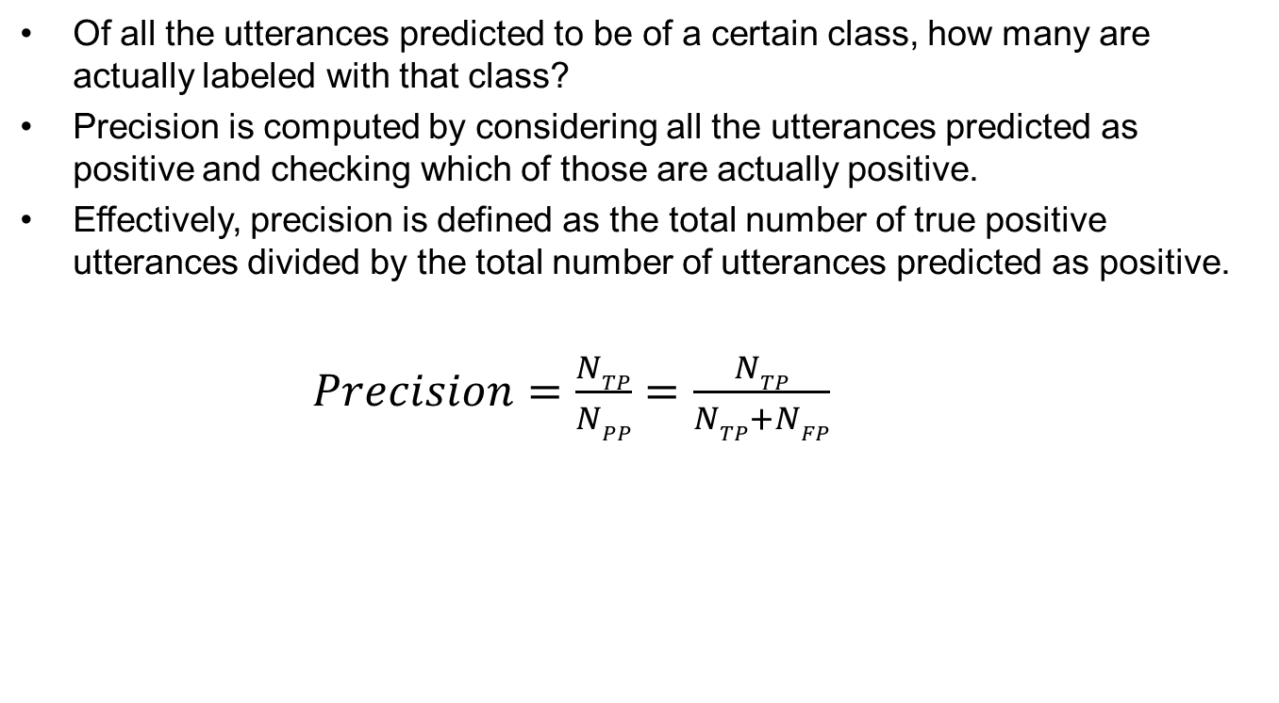
Precision
Of all the utterances predicted to be of a certain class, how many are actually labeled with that class?
Precision is computed by considering all the utterances predicted as positive and checking which of those are actually positive.
Effectively, precision is defined as the total number of true positive utterances divided by the total number of utterances predicted as positive.
$Precision=\frac{NTP}{NPP}=\frac{NTP}{NTP+NFP}$

Slide 43
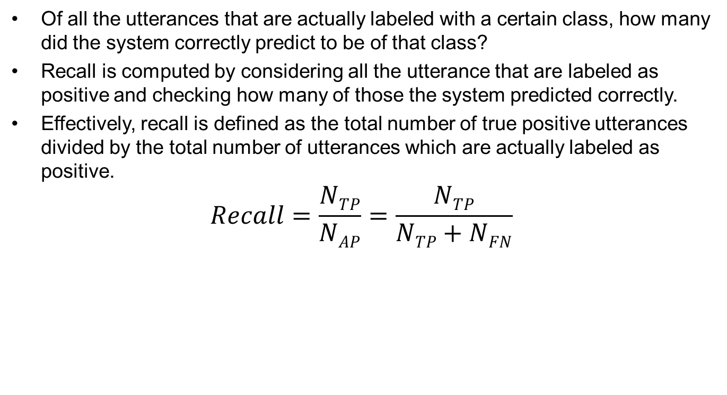
Recall
Of all the utterances that are actually labeled with a certain class, how many did the system correctly predict to be of that class?
Recall is computed by considering all the utterance that are labeled as positive and checking how many of those the system predicted correctly.
Effectively, recall is defined as the total number of true positive utterances divided by the total number of utterances which are actually labeled as positive.
$$Recall=\frac{NTP}{NAP}=\frac{NTP}{NTP+NFN}$$

Slide 44
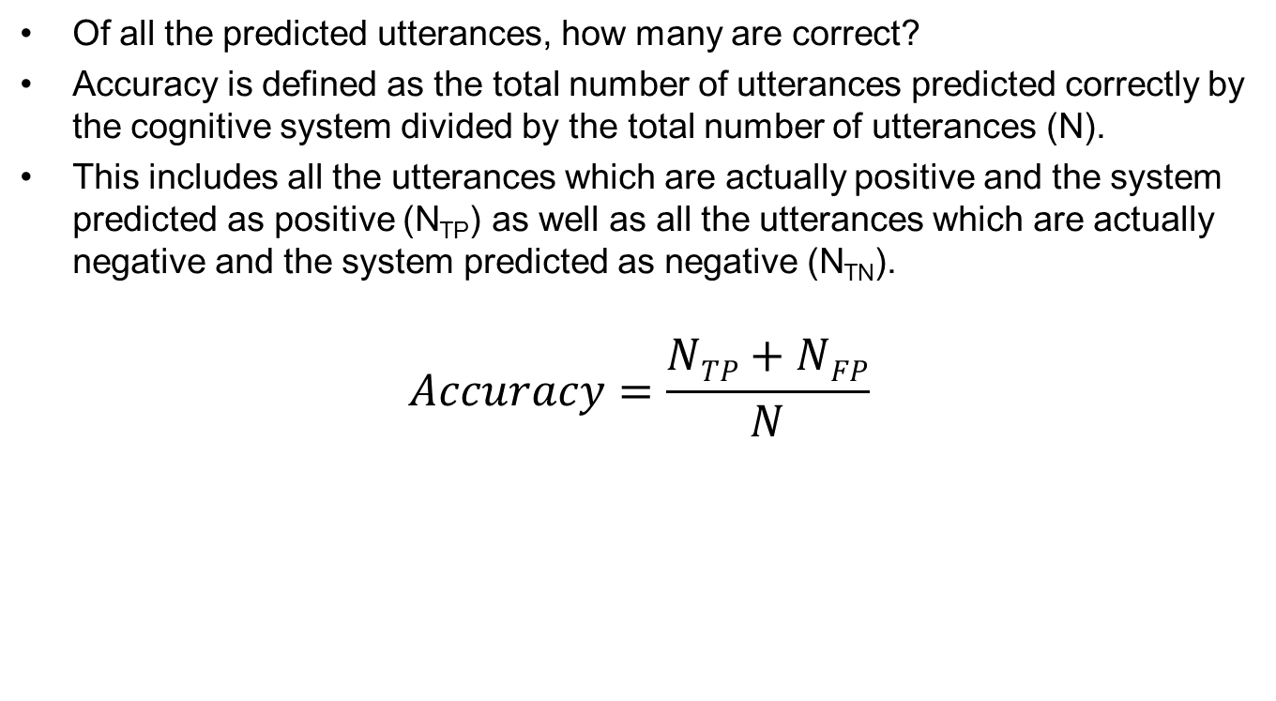
Accuracy
Of all the predicted utterances, how many are correct?
Accuracy is defined as the total number of utterances predicted correctly by the cognitive system divided by the total number of utterances (N).
This includes all the utterances which are actually positive and the system predicted as positive (N_{TP}) as well as all the utterances which are actually negative and the system predicted as negative (N_{TN}).
$$Accuracy=\frac{NTP+NFP}{N}$$

Slide 45
Importance of separating training, validation and test data
In supervised learning, there are two types of datasets needed:
1. In one dataset – the input data mapped with correct/expected output.
2. The data you are going to apply your model to – no expected output available as yet.
In Cognitive learning, the phases are:
Training phase
Validation phase(validate and test)
Application phase
70/30 recommended for partitioning the data set across training and validation.

Slide 46
Measure accuracy of service, Intents and Classes
The goal of the model is to learn patterns that generalize well for unseen data instead of just memorizing the data that it was shown during training.
Once the model is ready, it is important to check if your model is performing well on unseen examples that you have not used for training the model.
To do this, you use the model to predict the answer on the evaluation dataset (held out data) and then compare the predicted target to the actual answer (ground truth).
Clustering or classification based on some measure of inherent similarity or distance given the input data is called intents or classes.
Classes may include images…
Intent is a similar clustering for written utterances in unstructured natural language format.

Slide 47
Ground truth versus corpus
Ground truth - consists of inputs (questions) and approved outputs (answers).
Corpus - a collection of all the text that was used for annotation in NLP to search for the truth.

Slide 48
Domain Adaption using Watson Knowledge Studio
IBM Watson Knowledge Studio is a cloud-based application that enables developers and domain experts to collaborate on the creation of custom annotator components that can be used to identify mentions and relations in unstructured text.
Watson Knowledge Studio is:
Intuitive: Use a guided experience to teach Watson nuances of natural language without writing a single line of code
Collaborative: SMEs work together to infuse domain knowledge in cognitive applications.
Use Watson Knowledge Studio to create a machine-learning model that understands the linguistic nuances, meaning, and relationships specific to your industry.

Slide 49
Training the WKS
To become a subject matter expert in a given industry or domain, Watson must be trained.
The task of training Watson is with Watson Knowledge Studio.
WKS provides easy-to-use tools for annotating unstructured domain literature, and uses those annotations to create a custom machine-learning model that understands the language of the domain.
The accuracy of the model improves through iterative testing, ultimately resulting in an algorithm that can learn from the patterns that it sees and recognize those patterns in large collections of new documents.

Slide 50
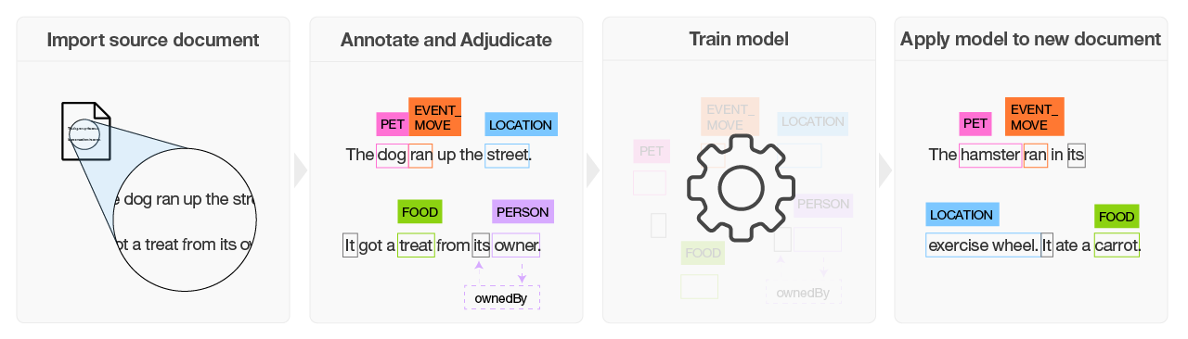
Build a machine-learning model

Slide 51
Working of WKS
Based on a set of domain-specific source documents, the team creates a type system that defines entity types and relation types for the information of interest to the application that will use the model.
A group of two or more human annotators annotate a small set of source documents to label words that represent entity types, words that represent relation types between entity mentions, and to identify coreferences of entity types. Any inconsistencies in annotation are resolved, and one set of optimally annotated documents is built, which forms the ground truth.
The ground truth is used to train a model.
The trained model is used to find entities, relations, and coreferences in new, never-seen-before documents.

Slide 52
Use Watson to:
Bootstrap annotation by using the AlchemyLanguage entity extraction service to automatically find and annotate entities in your documents. When human annotators begin to annotate the documents, they can see the annotations that were already made by the service and can review and add to them. See Pre-annotating documents with IBM AlchemyLanguage for details.
Import industry-specific dictionaries that you downloaded from IBM Bluemix Analytics Exchange.
Import analyzed documents that are in UIMA CAS XMI format. For example, you can import UIMA CAS XMI files that were exported from IBM Watson Explorer content analytics collections or IBM Watson Explorer Content Analytics Studio.
Deploy a trained model to use with the NLU & Discovery
Export a trained model to use in IBM Watson Explorer.

Slide 53
Working with WKS
Assembling a team
Human annotator
The human annotator is someone, typically a subject matter expert, who reviews domain documents to identify entities and relationships of interest to the domain. This user interacts with the application in a limited way; she uses the Ground Truth Editor to annotate a set of documents that have been assigned to her.
Project manager
The project manager is someone who helps to facilitate the creation of annotator components by performing such tasks as creating project artifacts, and training, creating, and deploying models. For projects that build machine-learning annotators, they also manage the document annotation process by assigning document review tasks to human annotators, adjudicating annotation conflicts, and approving documents to add to the ground truth.

Slide 54
Machine-learning model creation workflow
Create a machine-learning annotator that trains a model you can use to identify entities, coreferences, and relationships of interest in new documents.
Understand the typical workflow for creating a machine-learning annotator component in Watson™ Knowledge Studio.
All the steps are performed by the project manager, except for the Annotate documents step, which is performed by the human annotator. Because human annotators are often subject matter experts, they might be consulted during the creation of project resources, such as the type system, also.

Slide 55
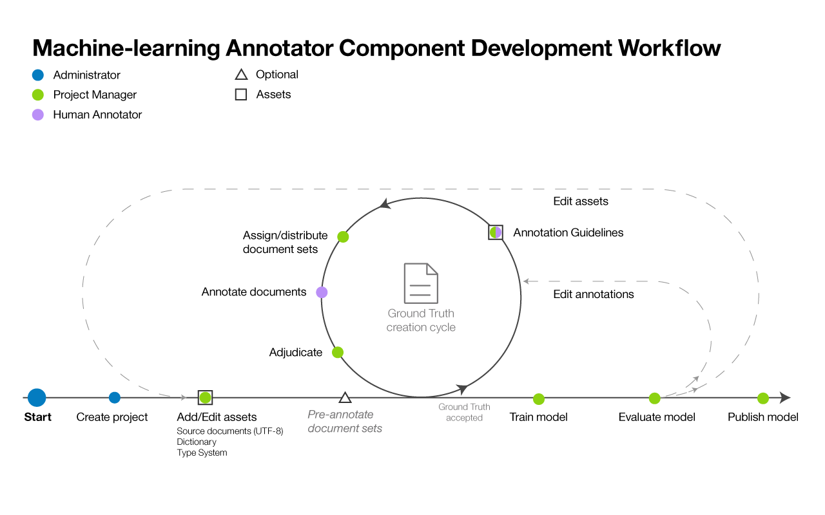
Machine-learning model creation workflow

Slide 56
Steps in creating Machine-learning model
Create a project.
A project contains the resources that are used to create the annotator component, including:
Type system
Import or create the type system, and define the entity types and relation types that human annotators can apply when annotating text. The annotator process manager typically works with subject matter experts for your domain to define the type system.
Source documents
Create a corpus by importing sample documents that are representative of your domain content into the project..
Partition the corpus into document sets, specify the percentage of documents that are shared among all document sets, and assign the document sets to human annotators.
Dictionaries
Import or create dictionaries for annotating text. You can choose to manually add dictionary entries or import entries from a file, and then edit the entries..

Slide 57
Steps in creating Machine-learning model
Annotate documents
The project manager assigns annotation tasks to human annotators, configures the inter-annotator agreement threshold, and provides annotation guidelines for the human annotators to follow.
Human annotators use the Ground Truth Editor to manually annotate documents. A human annotator identifies mentions of interest in your domain content and labels them with entity types. The human annotator also identifies relationships between mentions (for example, Mary is an employee of IBM) and how the mentions co-reference the same entity (such as an occurrence of "she" that refers to Mary)

Slide 58
Steps in creating Machine-learning model
Adjudicate and promote documents
Accept or reject the ground truth that was generated by human annotators, and adjudicate any annotation differences to resolve conflicts. Evaluating the accuracy and consistency of the human annotation effort might be the responsibility of a senior human annotator or a user with stronger subject matter experience than the project manager
Train the model
Create the machine-learning annotator component
Evaluate the model
valuate the accuracy of the annotator component.
. Depending on annotator accuracy, this step might result in the need to repeat earlier steps again and again until optimal accuracy is achieved
Publish the model.
Export or deploy the mode
.

